Slide 1
NSH Updates 2020
Colleen L. Forster
Region V Director

Slide 2
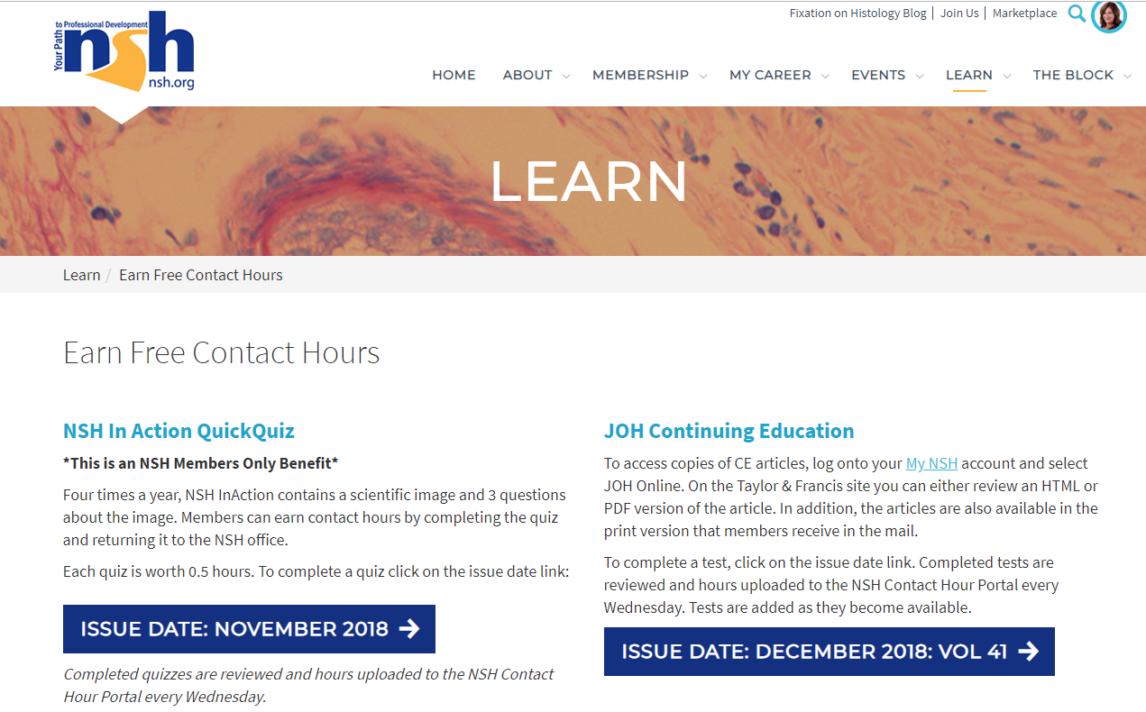
Education to Advance your Career
NSH is the leading provider of histology focused education. Opportunities for continuing education this year include:
6 Free Contact Hours Annually available to members through publication quizzes: https://www.nsh.org/learn/earn-free-hours
Notes:
NSH is the leading provider of histology focused education. Our members receive 6 FREE contact hours annually included in their membership dues. Visit the “Learn” section on nsh.org for more details.

Slide 3
Education to Advance your Career
Digital Pathology Certificate of Completion: New Modules
IHC Hands-On Forum: Midwest and West
QIHC Prep Course/NEW QIHC Study Group
HT Prep Course / HTL Prep Course coming soon
QLS Prep Course
Florida Mandatory Education Package
Notes:
NSH is well-respected for its hands-on learning opportunities. We will be updating the Digital Pathology Certificate of Completion. New modules will include Artificial Intelligence (AI), Big Data, Integration with LIS/LIM Systems, CAP QIP Guidelines.
NSH will hold its IHC Hands-On Forum again in St. Louis, and we will be adding an additional location, to be determined, out West. This dynamic hands-on learning opportunity has sold out the past two years, so we encourage you to register early if you are interested. Registration materials and agenda outlines are available two months prior to the seminar.
The QLS Prep Course is currently being recorded and will be out later this year on learn.nsh.org
For those of you with a Florida license, NSH has the Mandatory Education courses needed to renew by December 31, 2020. It includes the Medical Errors, Florida Laws and Rules, and the HIV/AIDS requirements. All available online via learn.nsh.org.
Last February NSH launched its QIHC Prep Course. This year we are launching a companion online study group via The Block. This is free to all NSH members and nonmembers who have registered for the Prep Course. The study group will be moderated by members of the IHC Committee and is a great way to prepare for the qualification exam.
Our HT prep course launched last year, and we are in the final stages of editing the HTL Prep Course scheduled to launch early this spring.

Slide 4
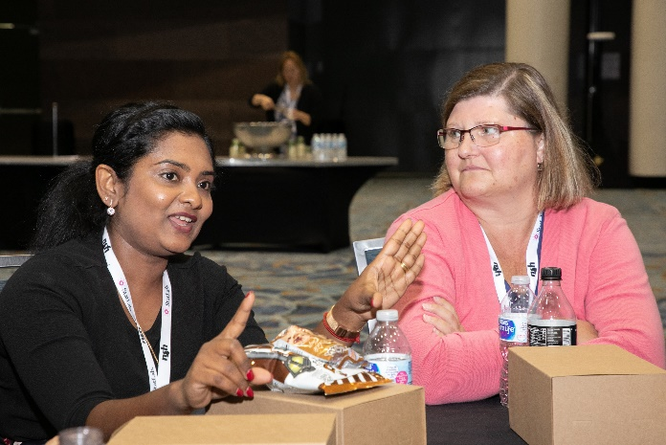
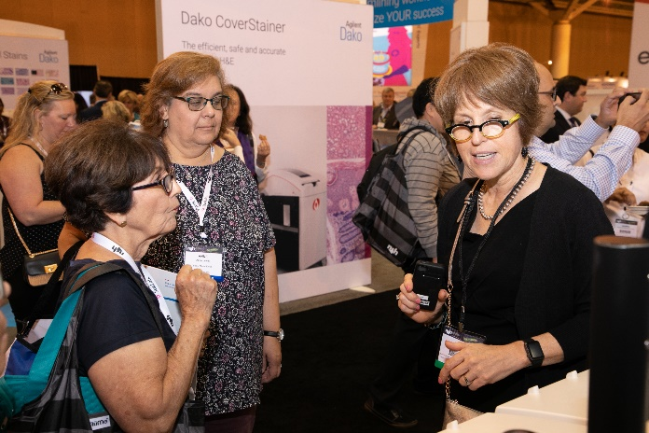
Education to Advance your Career
Annual Symposium/Convention (Oct. 16-21)
Reno, NV featuring GREAT room rates!
2019 Session format & pricing was a success
Opening reception for ALL on Saturday night
Awards moves to general sessions
House of Delegates moves to Tuesday
Notes:
This year’s annual Symposium/Convention experienced sold out registration and several enhancements based on research and meeting the ever-changing needs of histotechs. We switched to a one-hour workshop format, and the initial survey results showed 96 satisfaction rate. We will continue with the new streamlined pricing to make it easier to register and attend what sessions you want.
We are excited to announce that we will offer three general sessions which will also feature a presentation to our scholarship and award winners. In place of the annual awards dinner, we will now offer an opening party to start the Annual Symposium/Convention with a bang, proving more opportunity to have fun and make new connections. There is no additional charge to attend. We are also bringing back continental breakfast for attendees.
The House of Delegates meeting will be moved to Tuesday.

Slide 5
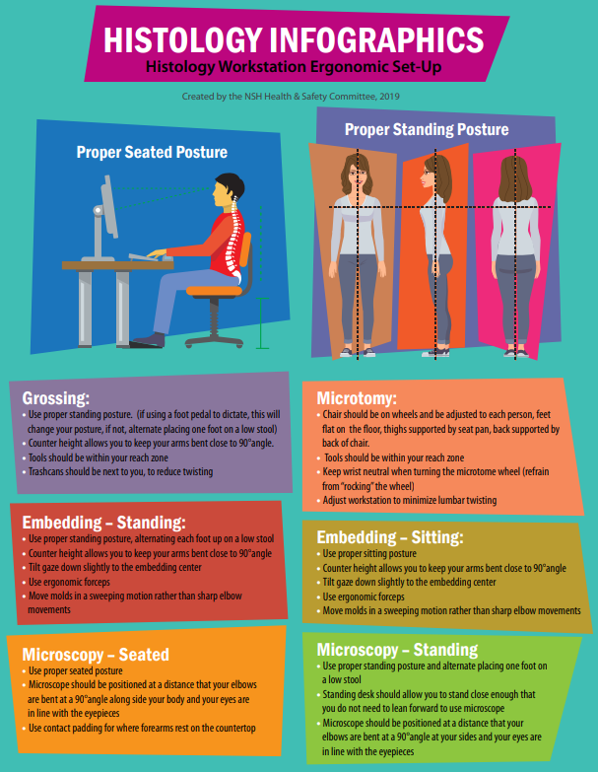
Workforce Development
Lab Webinars
2019 Workload Study
New Infographics
Notes:
NSH’s annual laboratory webinar series is a cost-efficient way to met your continuing competence requirements. For $1,595 your entire lab can earn 12 CEUs. All webinars are recorded and made available on demand.
The Quality Management Committee conducted the Workload Study last year. The results will be published in the Journal of Histotechnology’s March issue. All NSH members have access to the journal as a part of their membership.
The Health and Safety Committee has published two new infographics. The Infographics are available on The Block under the resources heading in the Health & Safety Folder. The 2019 graphics focus on keeping lab staff healthy.

Slide 6
Journal of Histotechnology
Gayle Callis, Editor in Chief
Aims & Scope updated
Accepted to be indexed Medline in 2019
Notes:
.We are thrilled to share that the NSH Board of Directors officially appointed Gayle Callis as Editor in Chief to the Journal of Histotechnology. A strategic review of the journal was conducted over 2018 and 2019 which resulting in updating our Aims & Scope and refreshing the editorial board. Under Gayle’s guidance and with assistance from Dr. Yongfu Wang, we are thrilled to share that after many years of trying, the Journal of Histotechnology was accepted for indexing on Medline. Our hope is that acceptance will continue to increase our manuscript submissions.
We will publish another special issue. The submission deadline is July 1, 2020. The Special Issue will be on Methods for Validating Histochemistry, Immunohistochemistry, In-situ Hybridization and Multiplexing Assays

Slide 7
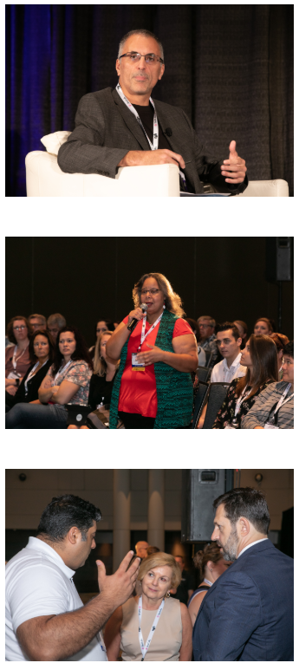
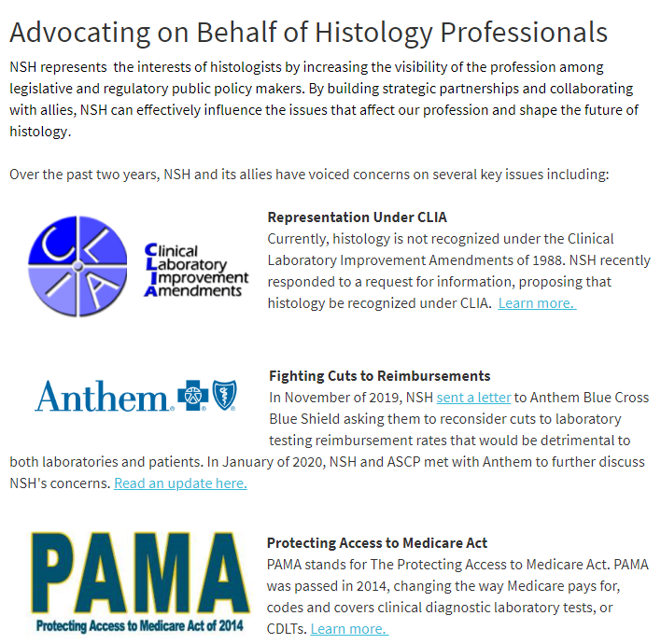
Advocacy on Your Behalf
Keep up to date on what NSH is doing for you by visiting our new Advocacy page on nsh.org.
Notes:
NSH is advocating on your behalf. In January NSH and the American Society for Clinical Pathology met with Anthem BlueCross BlueShield to discuss our concerns on the recent drastic cuts to anatomic pathology reimbursements. NSH has shared information on our work with Anthem via NSH in Action. Given the uptick in our advocacy work, we have created a page on our website to keep our members and the general public up to date with our work on the profession’s behalf.
NOTE: see article published in NSH in Action – in the Region Director’s folder.

Slide 8
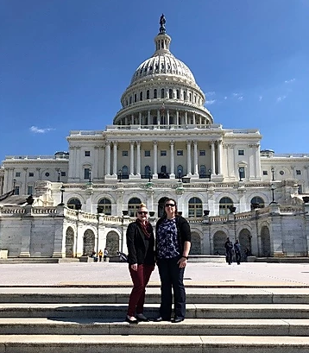
Advocacy on Your Behalf
NSH is working on behalf of the profession to raise awareness about important issues:
Clinical Laboratory Improvement Advisory Council (CLIAC)
CLIAC Laboratory Personnel Workgroup recommended that histotechnology should be recognized similar to cytotechnology under CLIA
ASCLS Legislative Symposium
NSH is a co-sponsoring organization
NSH attending to meet with representatives regarding key issues affecting the histology field
New Professional Legislative Leadership Scholarship: Bringing four new histologists to attend and learn
Notes:
As a follow up to the CMS RFI, NSH sent Clare Thornton to represent us at the Clinical Laboratory Improvement Advisory Council (CLIAC) this past November at the Centers for Disease Control in Atlanta, GA. As a result, she was appointed to the CLIAC Laboratory Personnel Workgroup charged with studying and reporting back on laboratory personnel requirements. We will keep the membership updated via NSH in Action, and Fixation on Histology.
NSH Executive Director Sharon Kneebone, and Region I Director Luis Chiriboga attended both CLIAC meetings in 2019. We have been successful in asking the council to ask more questions about how histotechnology should be recognized under CLIA. We will continue to attend the meetings until we attain our goal of recognition under CLIA.
Our focus during this year’s Legislative Symposium will be on Work Force Development, and a legislative ask to help support an increase in clinical education sites.

Slide 9
Governance Update
House Passes New Membership Category: Premium Membership.
Additional Fee will include all 1-hour on- demand webinars, with a minimum of 12 new webinars added annually.
Additional discount on longer courses such at eh QIHC Prep course or Digital Pathology Certificate
Premium Members will be able to register for the Annual Meeting first
Anniversary Membership
Notes:
For an additional fee, histotechs can join NSH as a premium member and access all the education they need to renew their credentials. All one-hour on-demand webinars will be included with membership as well as additional discounts above those received by professional members (our current membership model). Additionally we will switch to an anniversary membership model. This means that if you join in July, your membership will expire June 30 of the following year. Or, if you join in August your membership will expire July 31 of the following year. It is more member centric and should make it easier for those who wish to join outside of a calendar year.

Slide 10
Governance Update
2020 Elections: nsh.org/volunteer/nsh-election
Bylaws administrative language was passed
Amended Bylaws are in located in The Block
Committee amendments did not pass
Bylaws will work on concerns and bring to 2020 House for consideration
The Board of Directors recognized the Maryland Society as an NSH Constituent Society at its September 25th meeting
Notes:
We are currently accepting nominations for the following Board positions:
President-Elect
Region Directors for Region, II, III, IX.
A special election for Region VII will be held due to the resignation of the Region VII director.
The deadline to receive nomination sis March 15, 2020.
The House will elect a new Speaker in October. Interested parties should plan on submitting information in July to be shared with the House agenda.
Be sure to visit nsh.org for more information, including position descriptions and nominations forms.

Slide 11
Awards and Scholarships
Student Scholarships
Professional Scholarships
Awards
New Professional Legislative Leadership Scholarship
Student Symposium Leadership Scholarship
Notes:
Student scholarships were open for submissions in February and Professional scholarship and Awards nominations will open in March. The new Professional Legislative Leadership Scholarship will open in December for awardees to attend the annual March Legislative Leadership Symposium in Washington, DC where members will advocate for the profession to the elected leaders and their staff.

Slide 12
HistoTalks: NSH Podcasts
Notes:
NSH has 90 episodes available in the following topics: HistoHelp, 2019 Symposium/Convention Poster Series, 2020 Lab Week Career Podcasts, Awards Casts (new episodes coming in May), and an episode on Advocacy and NSH’s work on CLIA and histotechnology. These are free and available to anyone, including nonmembers.

Slide 13
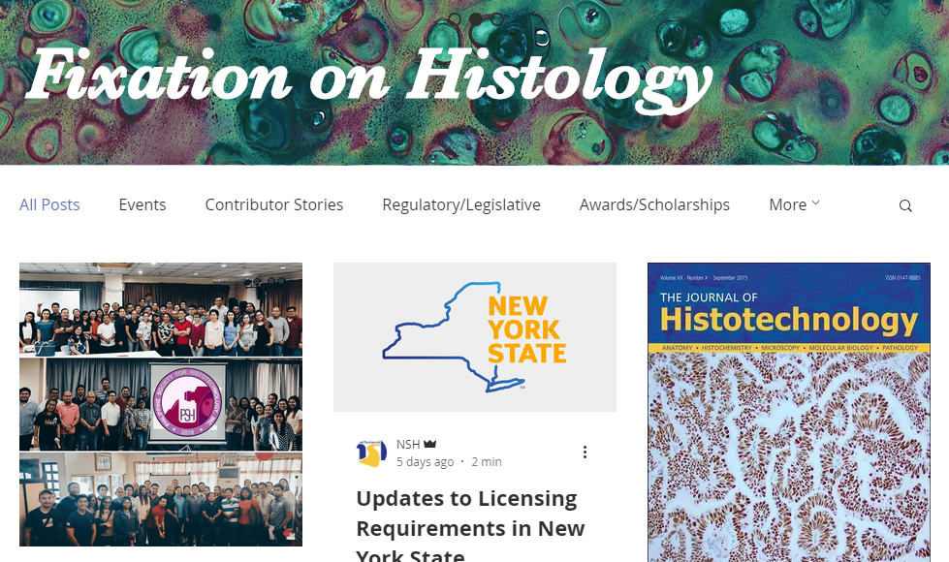
Fixation on Histology
Fixation on Histology: NSH’s blog featuring stories, advice and research from the histology field
Subscribe at https://www.fixationonhistology.com/home/
Seeking writers for the blog: If you are interested in contributing, email Natalie@nsh.org
Notes:
Last year NSH launched its blog, Fixation on Histology. We post twice weekly. If you haven’t already, it’s very easy to subscribe to the blog. Fixation on Histology is open to members and prospective members alike. We are always looking for guest bloggers. If you are interested, please email Natalie at the NSH office.

Slide 14
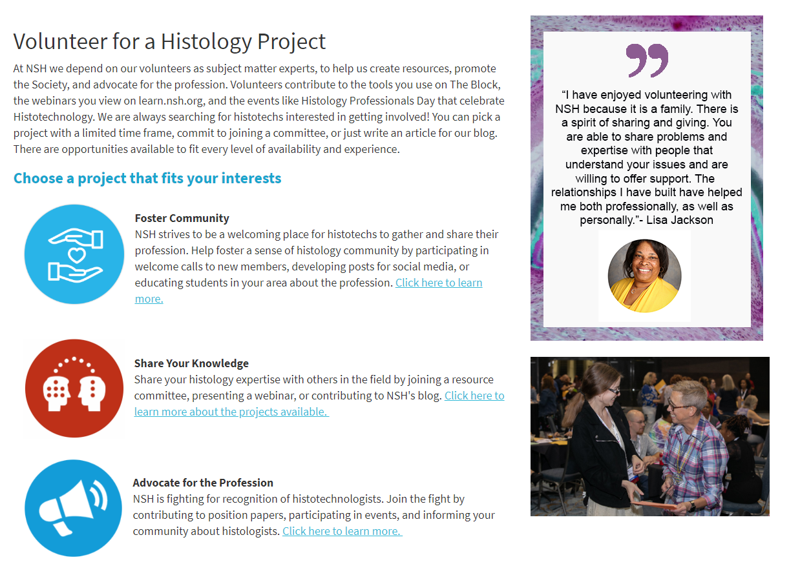
Get Involved
nsh.org/membership/volunteer
Notes:
We have recently updated our volunteer opportunities area of our website. Be sure to visit to see what opportunities we have available to be more involved with nsh! A call for volunteers will take place after the conclusion of the 2020 Elections.

Slide 15
Not an NSH member? Join online at
https://www.nsh.org/membership/nsh-membership
Notes:
NSH is here for you, and if you are not already a member, we would love for you to join.

Slide 16
Questions?
[Your name here]
[your email – or histo@nsh.org]
443-535-5060
Notes:
Any questions?

