Slide 1
MSH Website
Tri-State Meeting
April 24 to 26, 2013
Dubuque, Iowa

Slide 2

Website functions
Events/Seminars
  Programs
  Registration
Communication
  Histogram
  NSH (in development)
Manage Memberships
  Renewals
  Member drives

Slide 3
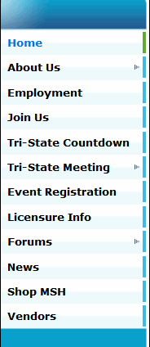
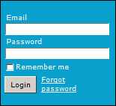
Navigating the website
The website index is on the left side of each page
The Log in box appears below the index
Members must log in to see all content
Forgot your password? Click on Forgot password!
Remember me doesn’t work ☹

Slide 4
Navigating the website
Members can control their own on-line privacy
Links are underlined and ‘usually’ blue
Links open a new page as another tab in your browser
Many links are PDF documents
PDF - View on-line, print, or save to your computer

Slide 5
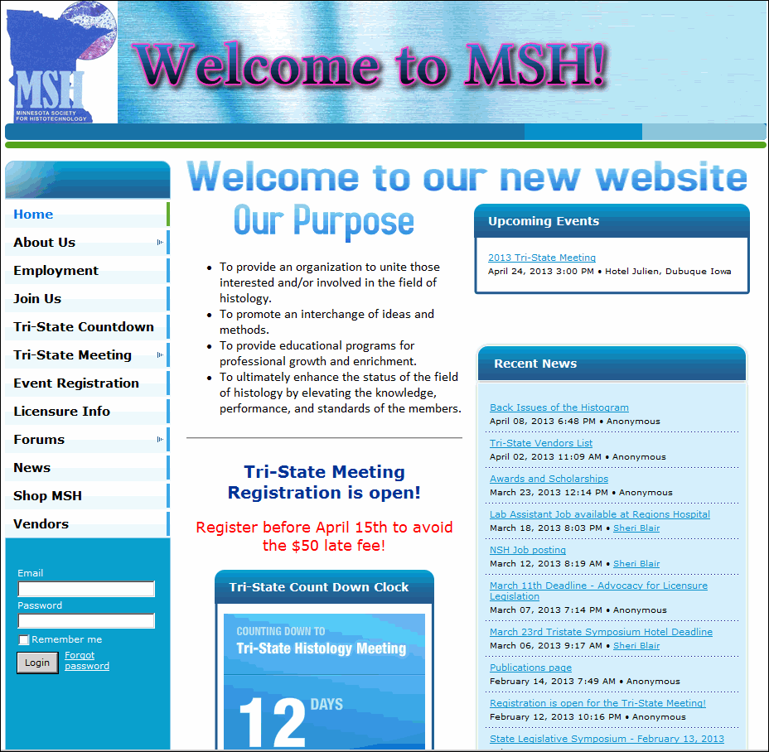
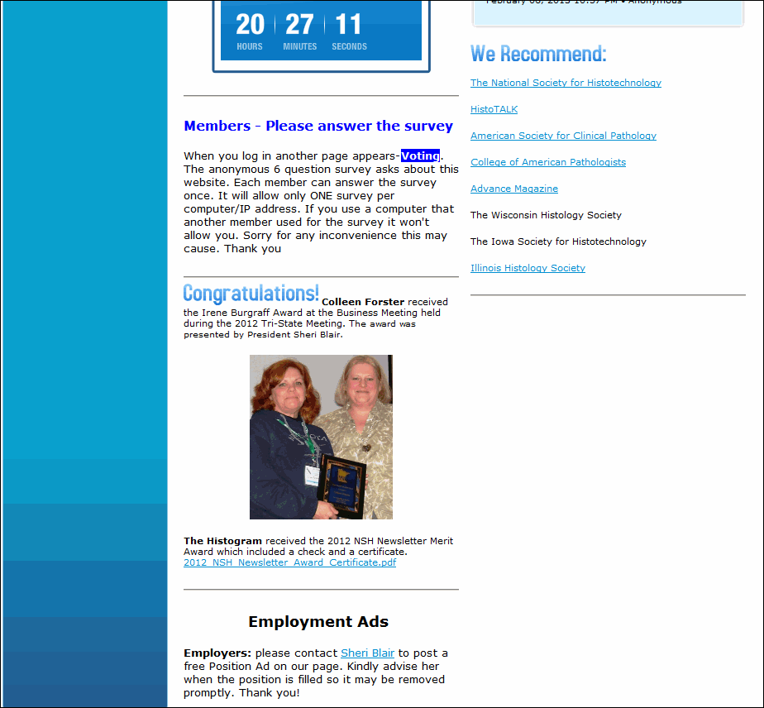
Public Pages
Home Page
  Purpose
  Upcoming Events
  Recent News
  Current Topics
  We Recommend
Log In section

Slide 6
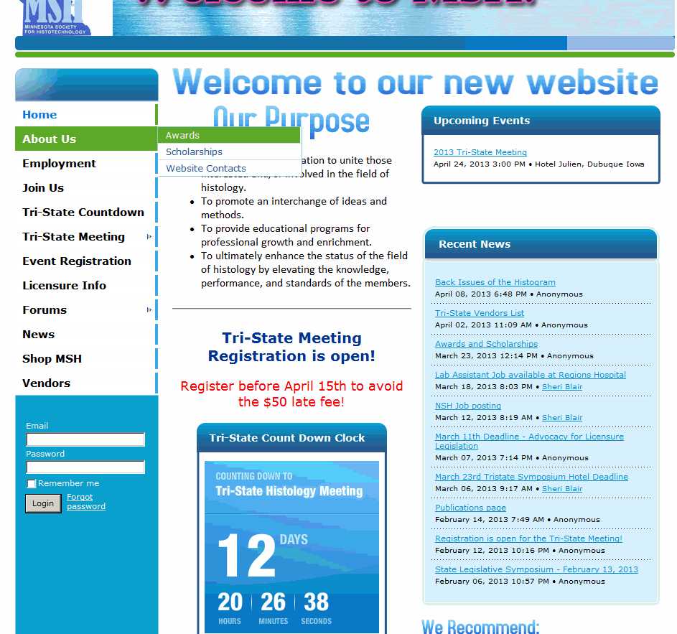
About Us
Awards
Scholarships
Website Contacts

Slide 7
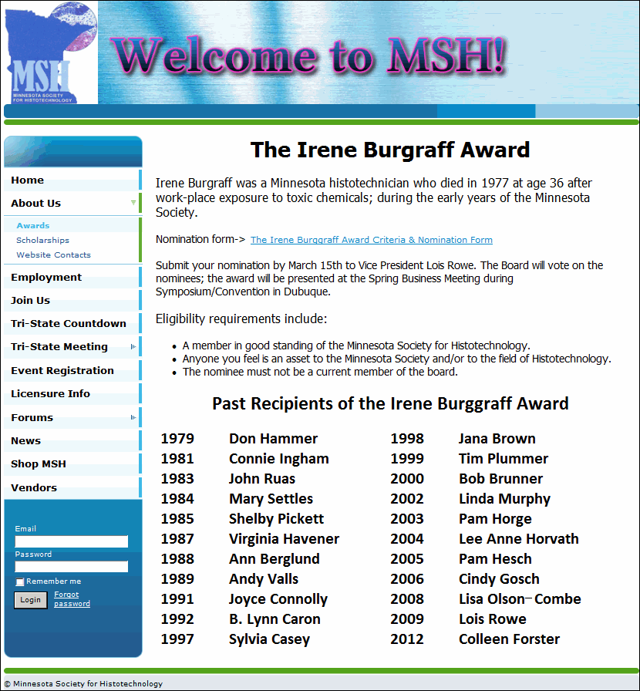
Awards Page
Burgraff Award Page
Nomination form link
Eligibility
Past Recipients

Slide 8
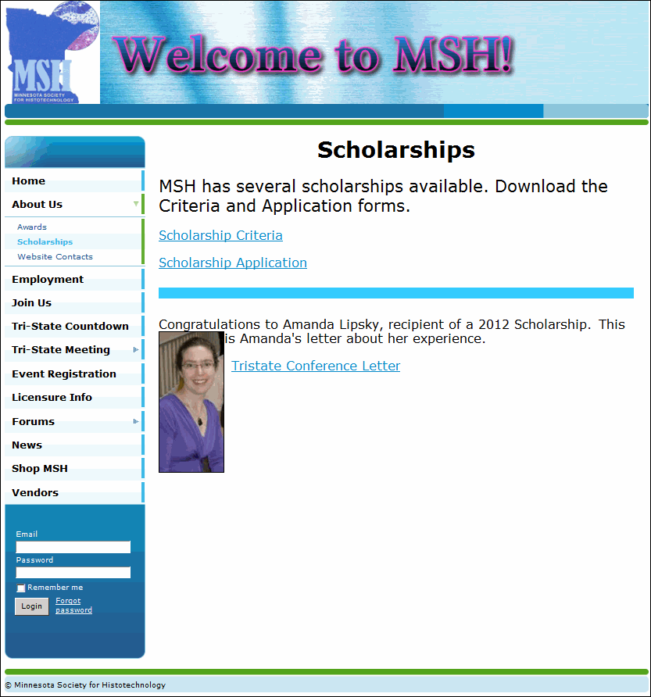
Scholarship Page
Scholarship Criteria form link
Scholarship Application form link
Comments from recipient(s)

Slide 9
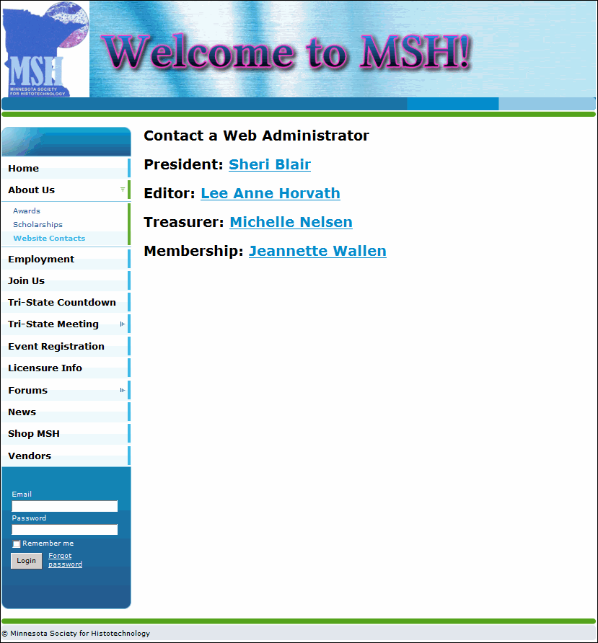
Website Contacts
Web Administrators
Linked names for ease in contacting them

Slide 10
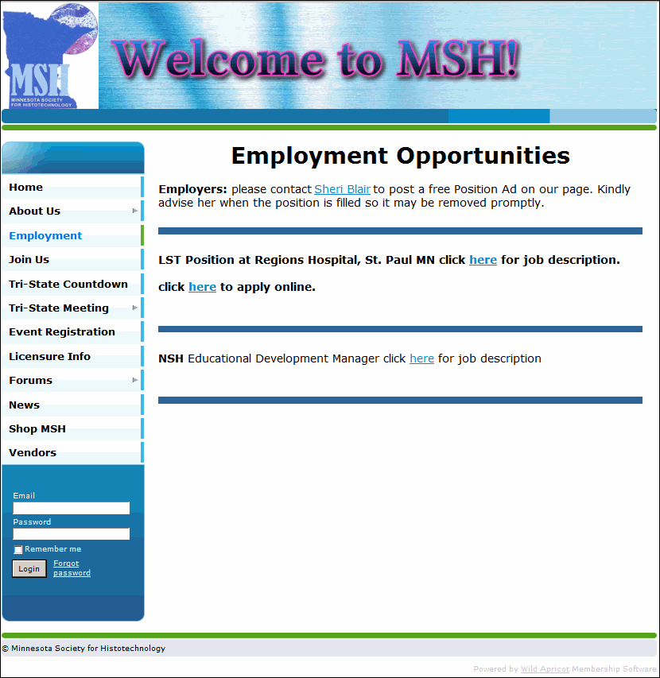
Employment Opportunities
Our goal is to maintain a current and dynamic page.
Positions will have links to appropriate websites and job descriptions.
As noted at bottom of Home Page, employers may contact Sheri directly.

Slide 11
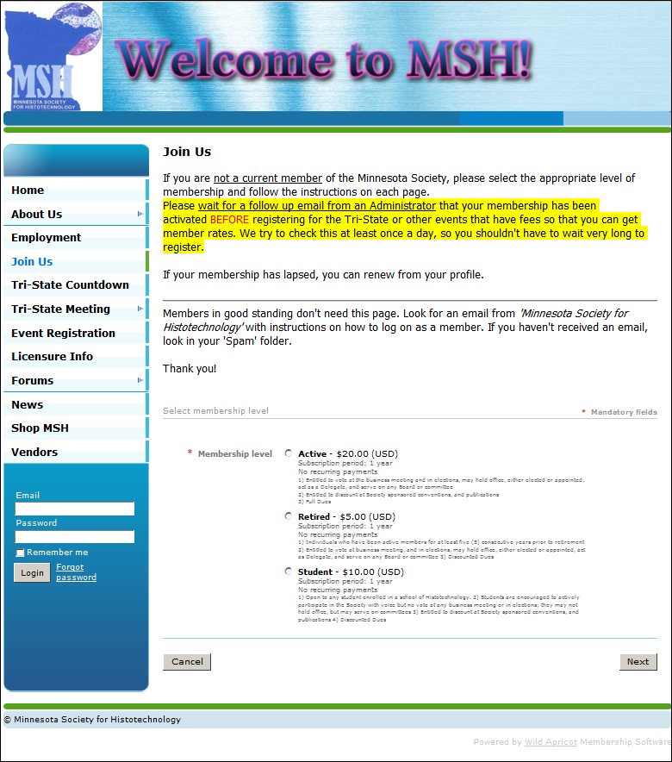
Join Us (never been a member before)
Review the paragraphs for instructions
Three membership types
All contacts/members since 2011 were imported into the database
Email address is the key
Follow prompts to complete membership
Pay on-line with PayPal

Slide 12
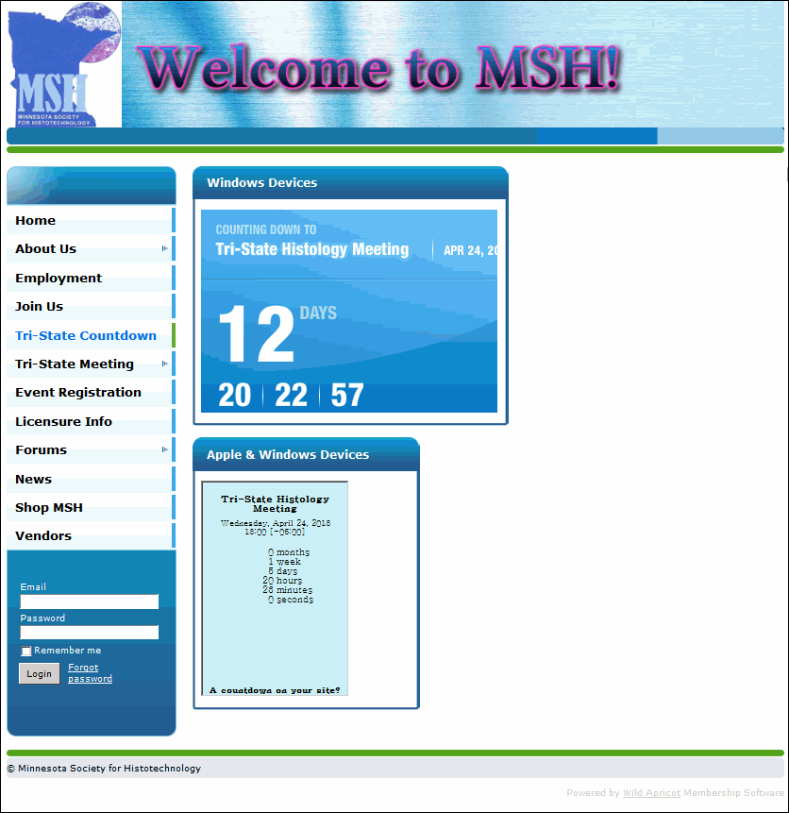
Tri-State Countdown Clock
This page will be removed soon.
It will reappear next year for the Tri-State in Rochester, MN!
Two versions on this page, one for Apple devices (Apple doesn’t allow Flash apps)

Slide 13
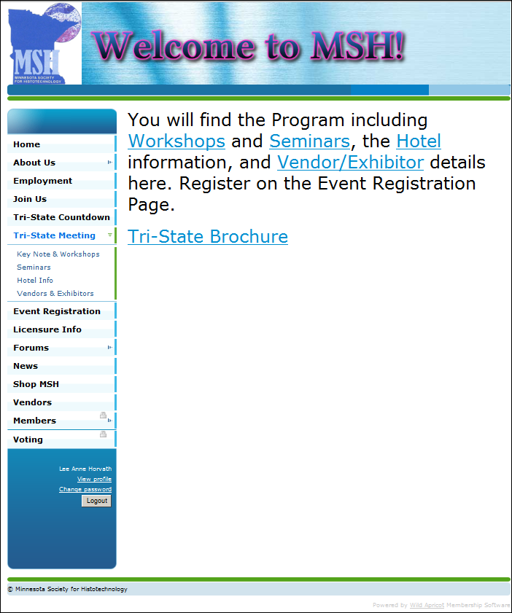
Tri-State Meeting
Five links
Workshops
Seminars
Hotel
Vendor/Exhibitor
Tri-State Brochure
These pages will be removed soon. They will reappear in 2014.

Slide 14
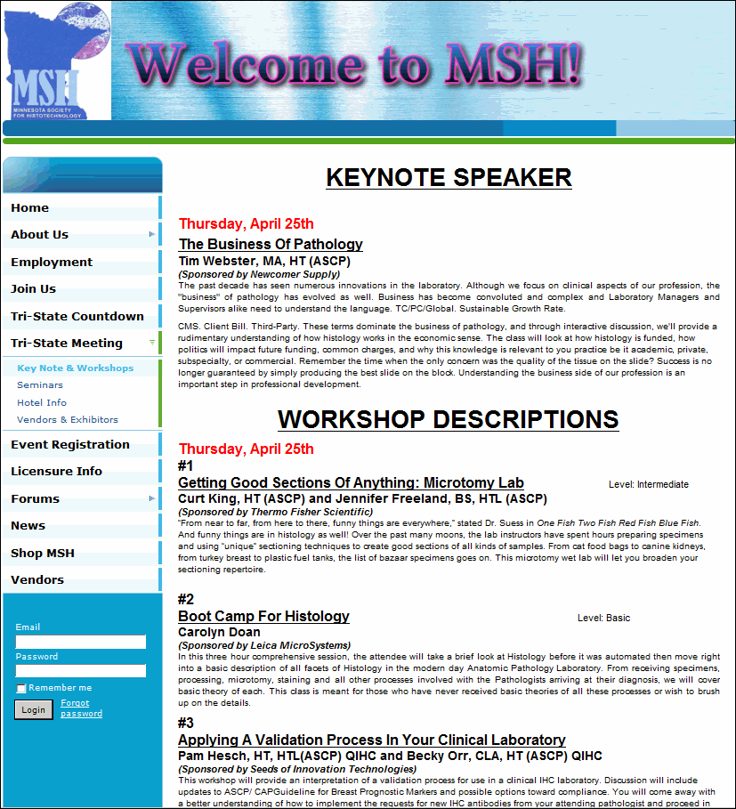
Tri-State Meeting
Keynote Speaker
Workshop Descriptions
Abstracts are listed
Date and time

Slide 15
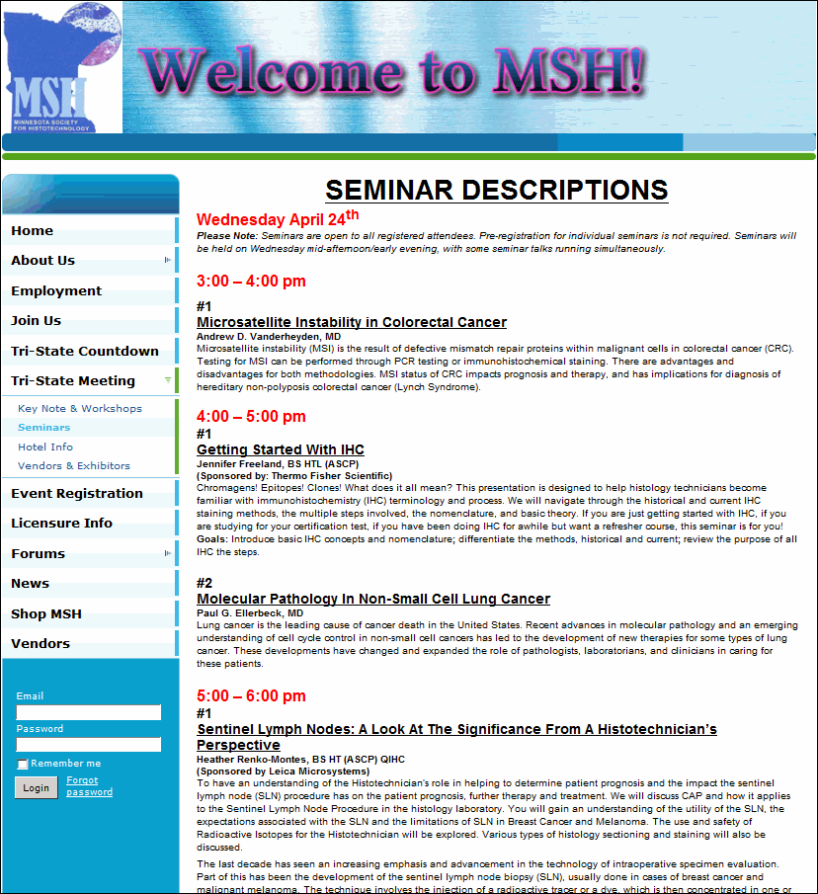
Tri-State Meeting
Seminar Descriptions
Abstracts are listed
Date and time

Slide 16
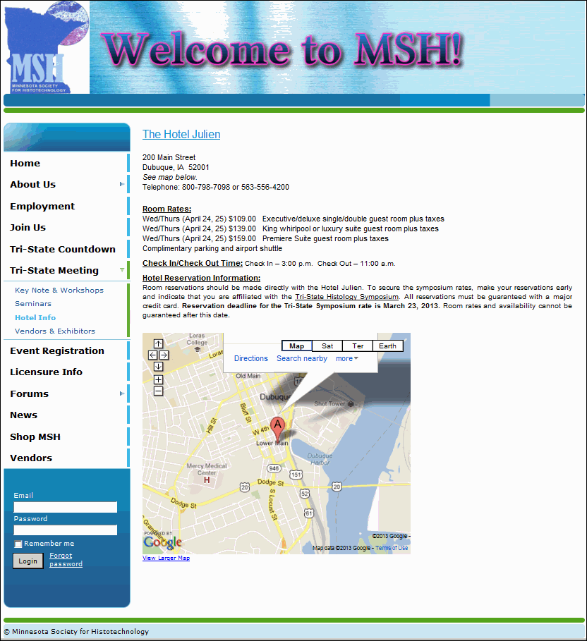
Tri-State Meeting
Hotel Information and link
Perhaps next year we can have on-line reservations

Slide 17
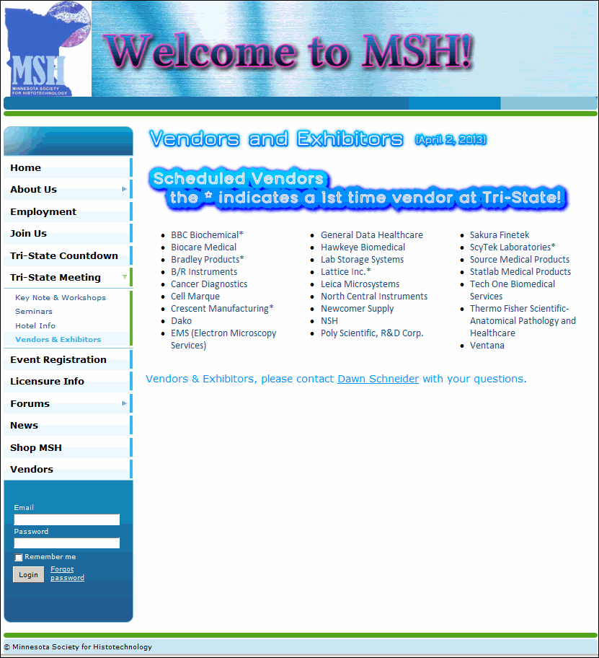
Tri-State Meeting
A list of the Vendors and Exhibitors
First time vendors were flagged with an asterisk*

Slide 18

Tri-State Meeting
A PDF of the brochure
PDF documents can be printed and / or downloaded to your PC.

Slide 19
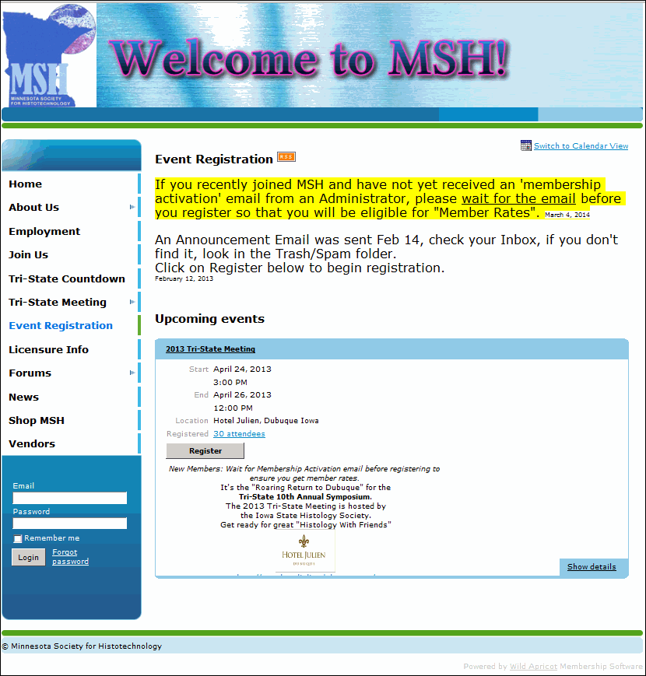
Event Registration
A Public Page
Click on Register
  OR
Log in first then your member information will autofill for you

Slide 20
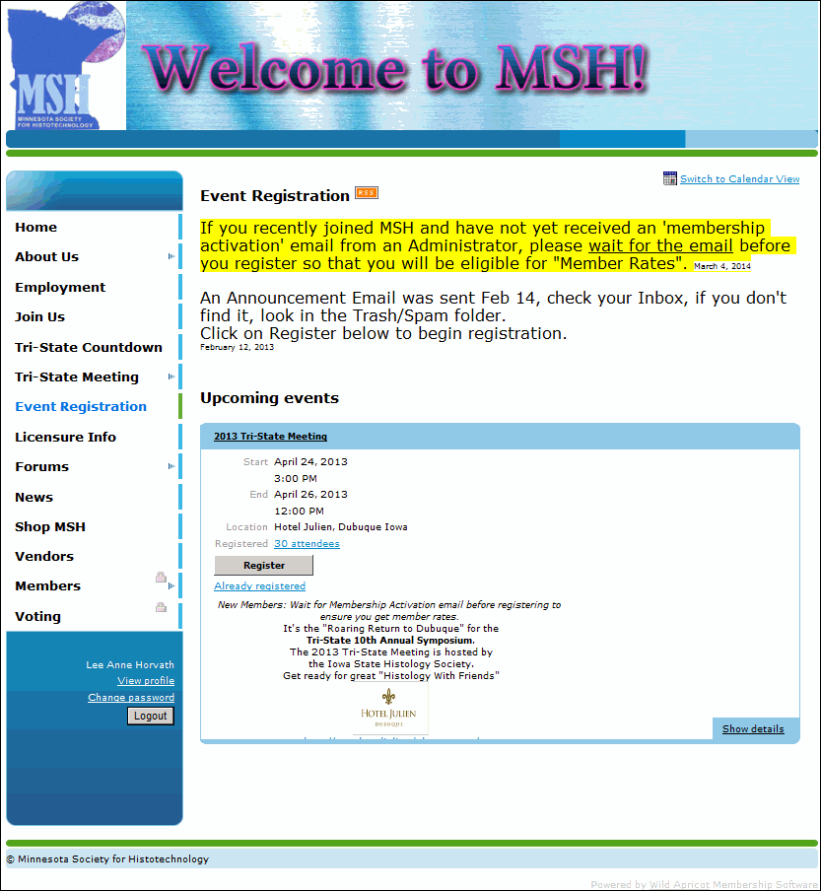
Event Registration (logged in)
Note the alert that she is already registered
Note member name in lower left corner

Slide 21
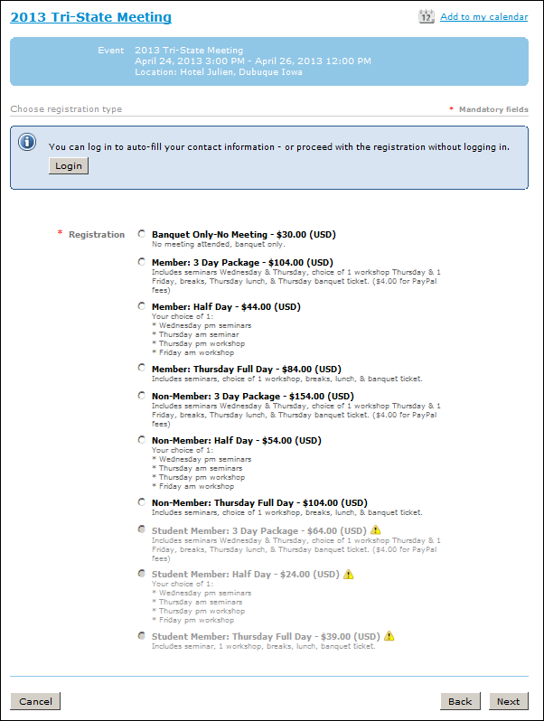
Event Registration
Read instructions/prompts
Select appropriate category; bold indicates available options
Complete additional information requested, i.e. workshop #, etc.
Complete payment on-line
Or an invoice will arrive by email
Confirmatory emails will follow

Slide 22
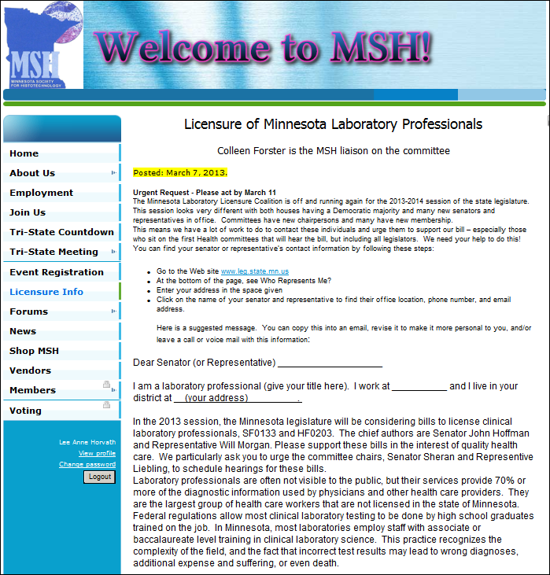
Licensure of MN Lab Professionals
Licensure Info
Colleen Forster will provide information for this page from the Lab Coalition

Slide 23
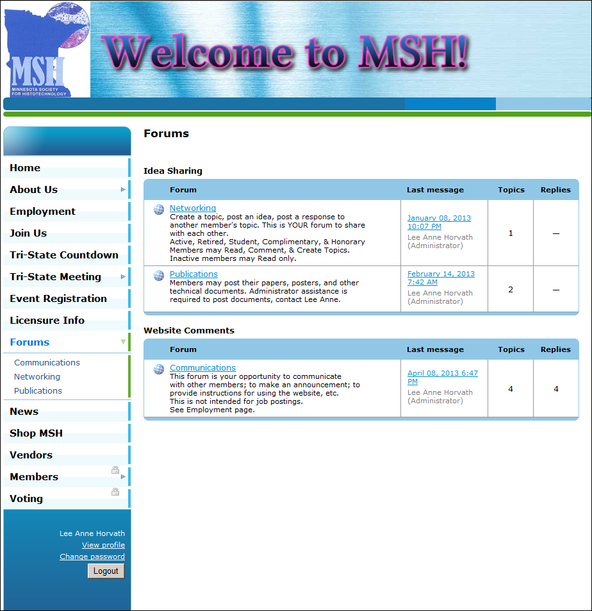
Forums
Public may “Read only”
Currently three forums
Networking
Publications
Communications

Slide 24
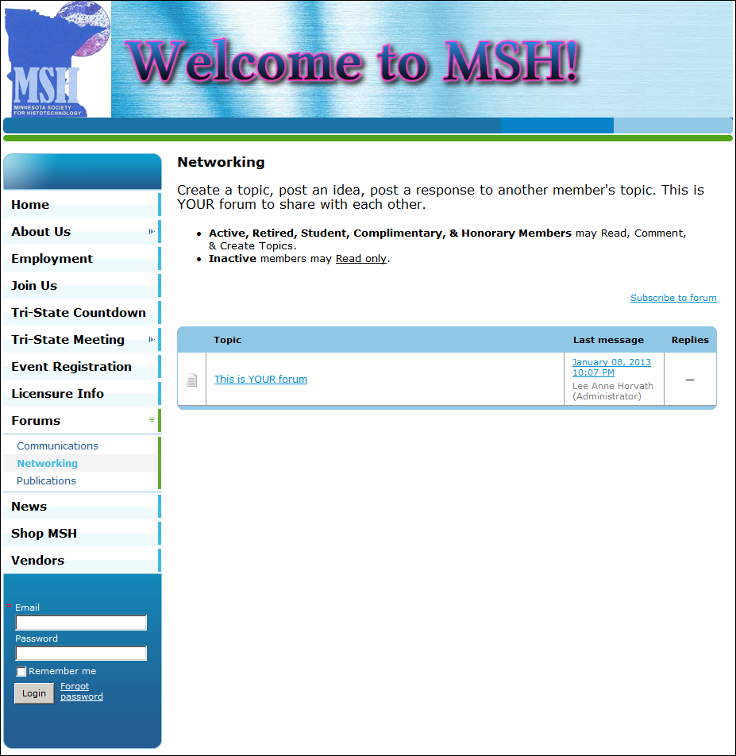
Forums - Networking
Members in good standing may:
  Read
  Comment
  Create topics
To receive email when a post is added, select ‘Subscribe to forum’
  Requires log-in

Slide 25
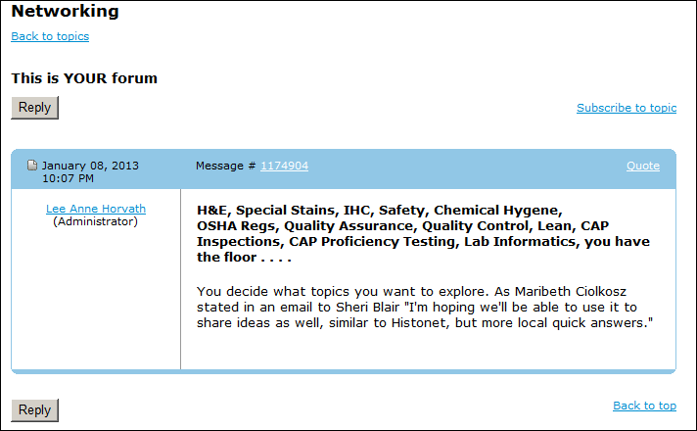
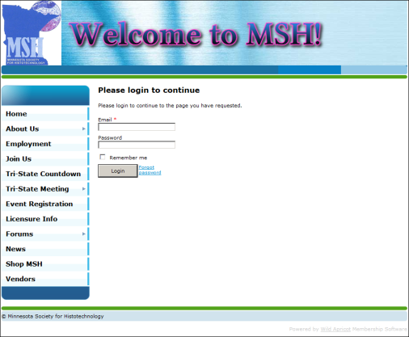
Forums - Accessing
Click on a link and the text opens.
You may Reply
You may “Subscribe to topic”
  You receive an email when another entry is made to the topic or discussion.
  If you aren’t logged in, you are prompted

Slide 26
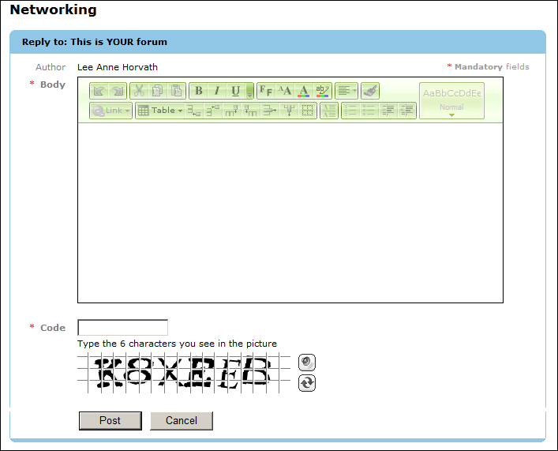
Forums – Accessing
Your name appears in Author field
Type your comment in the Body
A “Captcha” window requires you to type in a code before posting to prevent Spammers from hacking the site.

Slide 27
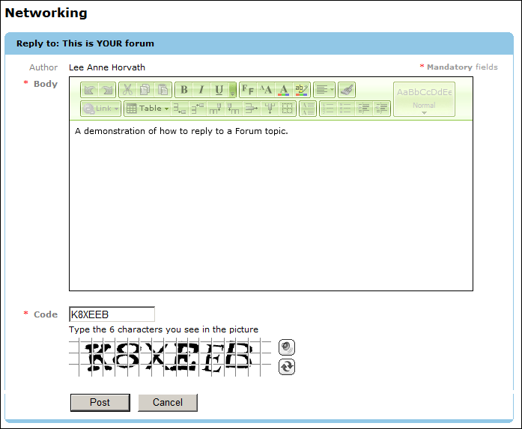
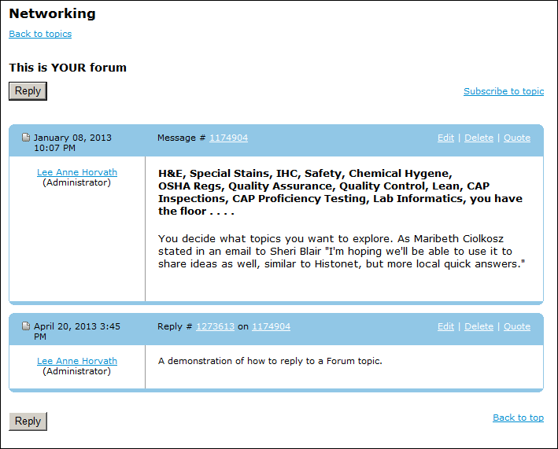
Forums – Adding a reply
Sample text in the Body
Code typed into the “Captcha” box
Next select Post
Results ☺

Slide 28
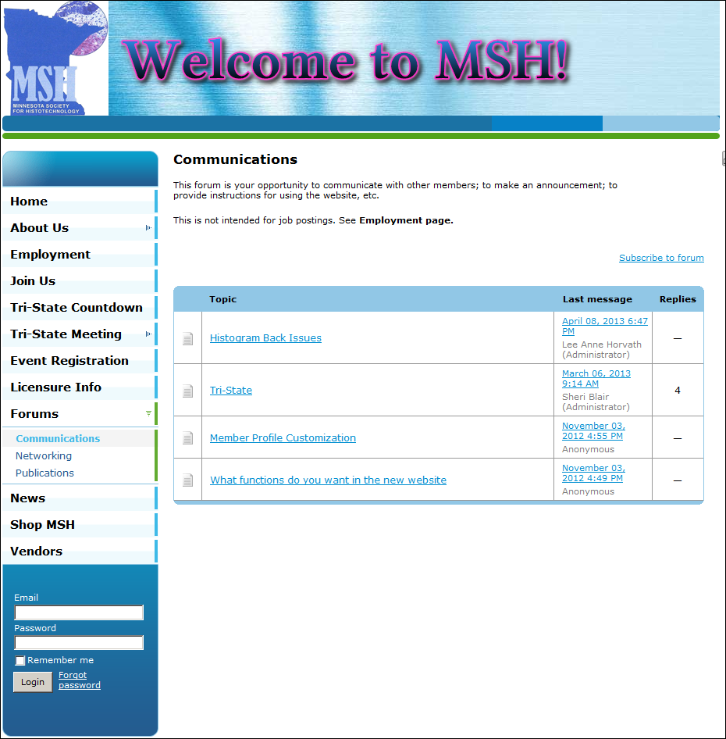
Forums – Communications
Topics discussed:
Member Profile customization
What website function are desired
Histogram back issues

Slide 29
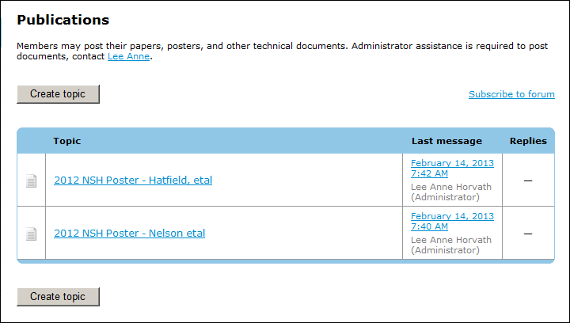
Forums - Publications
As noted on the top of the page, Administrator assistance is required to post documents (PDFs, etc.)
Contact Lee Anne or other Administrator for help

Slide 30
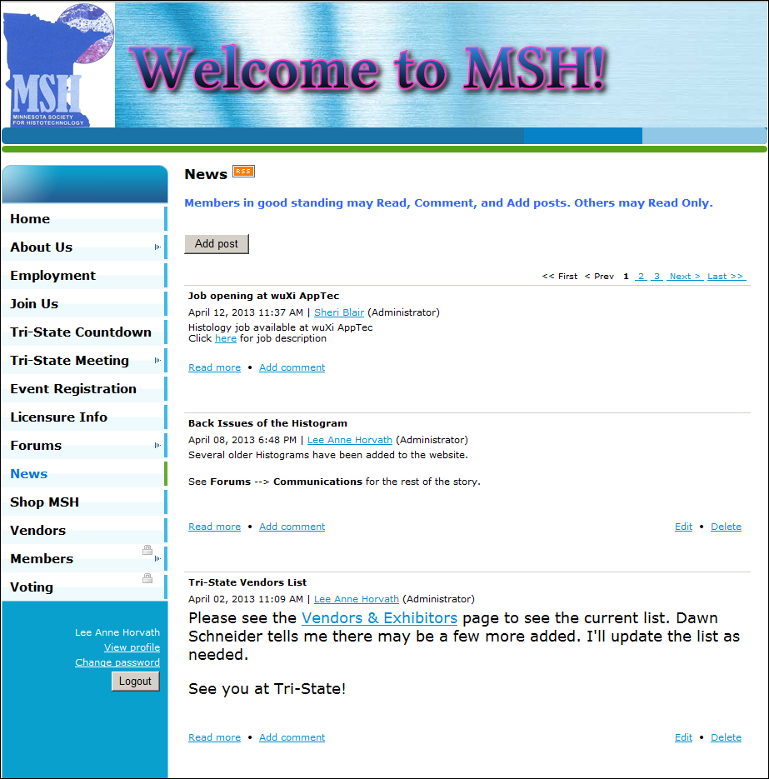
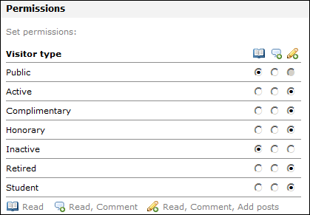
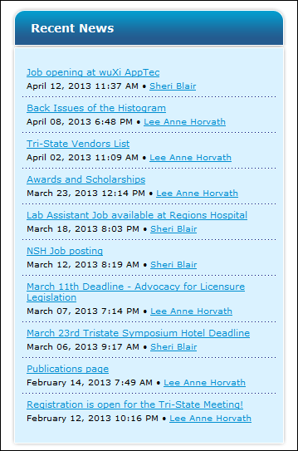
News - Blogging
Posts appear in reverse chronological order
Display of Recent News (on the Home Page)
Read Only for Public & Inactive Members

Slide 31
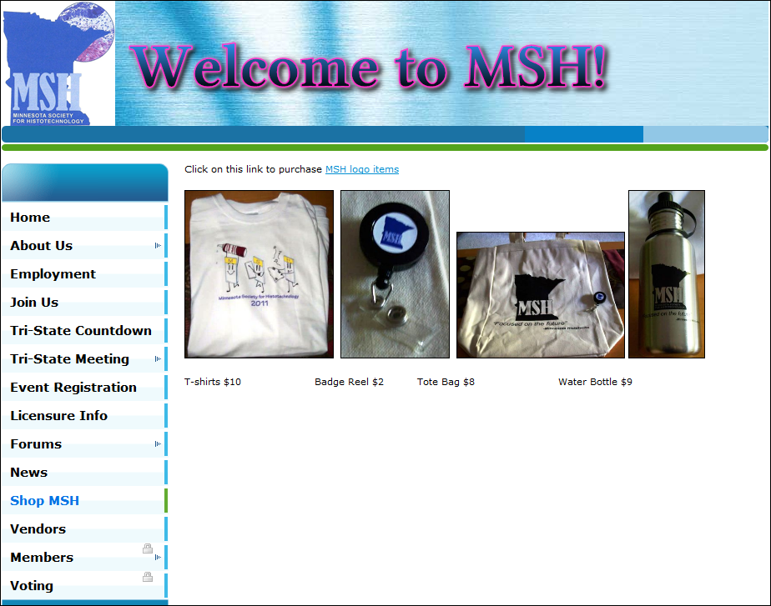
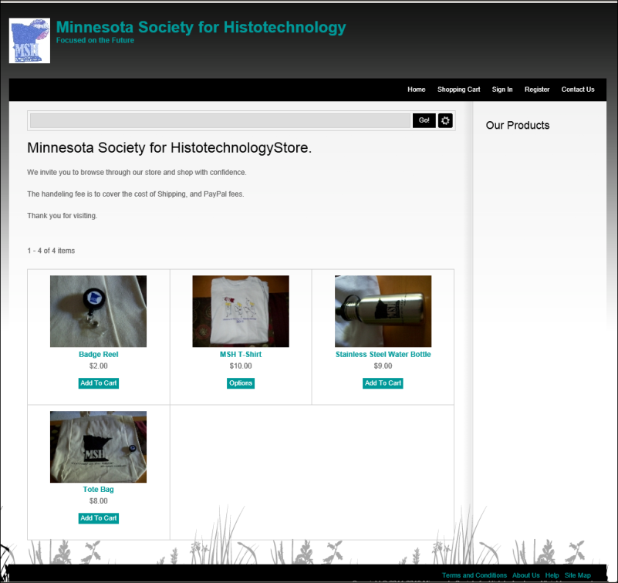
Shop MSH
Click on the link to shop for items
This website appears
A Handling Fee is added to cover shipping and PayPal charges

Slide 32

Vendors
Sponsors of the website and the Histogram
Click on a vendor logo and a new window will open to that company’s website

Slide 33
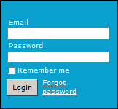
Members Only Content
Log in required to access these pages

Slide 34
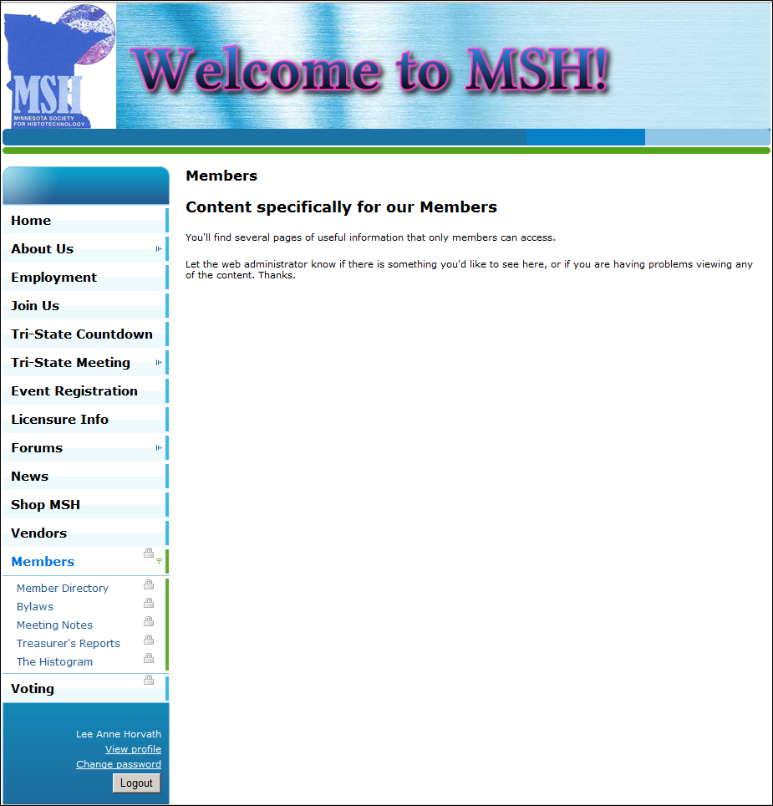
Members Only Pages
Five sub pages
Member Directory
Bylaws
Meeting Notes
Treasurer’s Reports
The Histogram

Slide 35
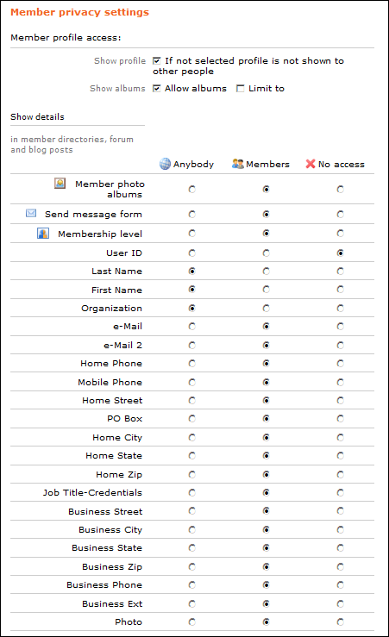
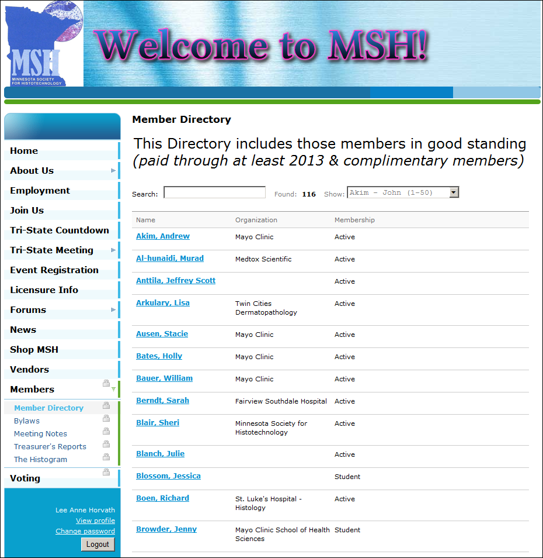
Member Directory
Each Member controls their own profile and privacy
These are the default values:

Slide 36
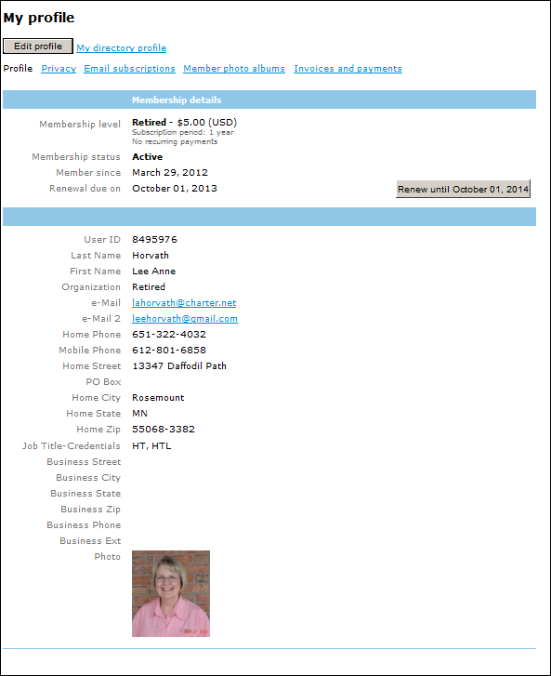
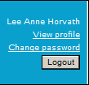
Your Profile
View profile is the place to start
Click Edit profile button
The information in our database.

Slide 37
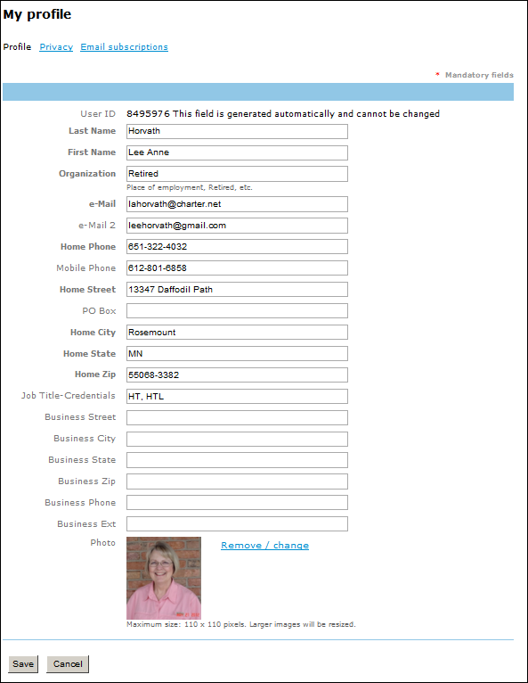
A Complete & Accurate Database
Review each line
Update as needed
Complete all fields, please!
Add a photo if you wish
Click Save
Click Privacy next
The next slide shows how to control the information seen by other members

Slide 38
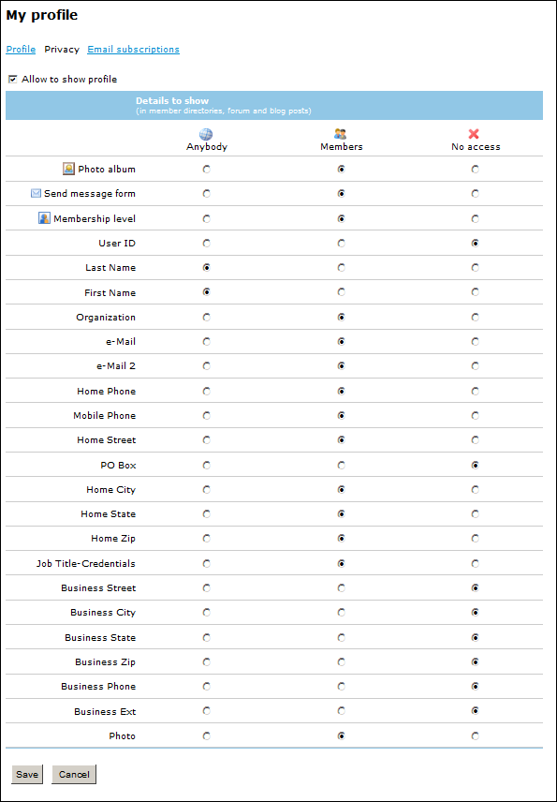
Your Profile Privacy
Privacy allows you to choose who has access to your information
Select the corresponding button for each line
“Allow to show Profile” check box
Select Save when done

Slide 39
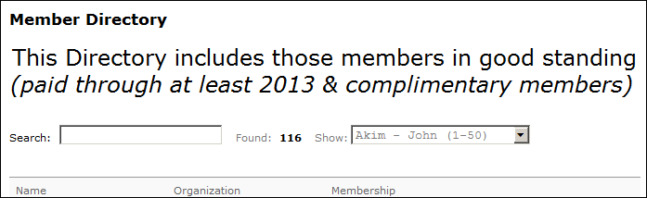
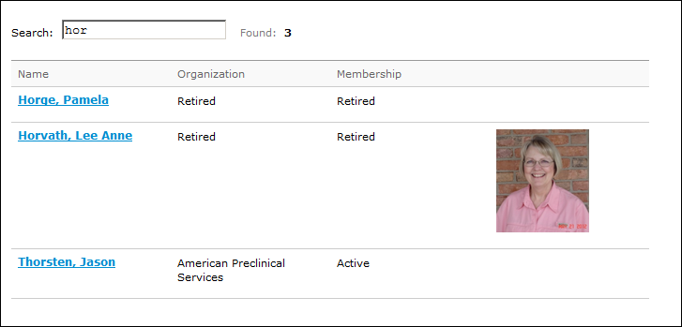
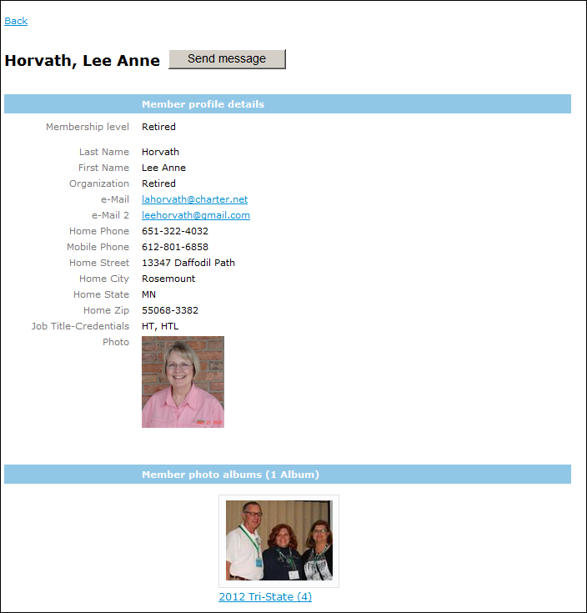
Member Directory
You many search by name or organization
Type in a few letters to narrow the search
Select person
Profile information is authorized by the member
Or it is the default if the member has not reviewed and modified the permissions
Click on Photo albums (if present) to see them
Click Send message button to send an email

Slide 40
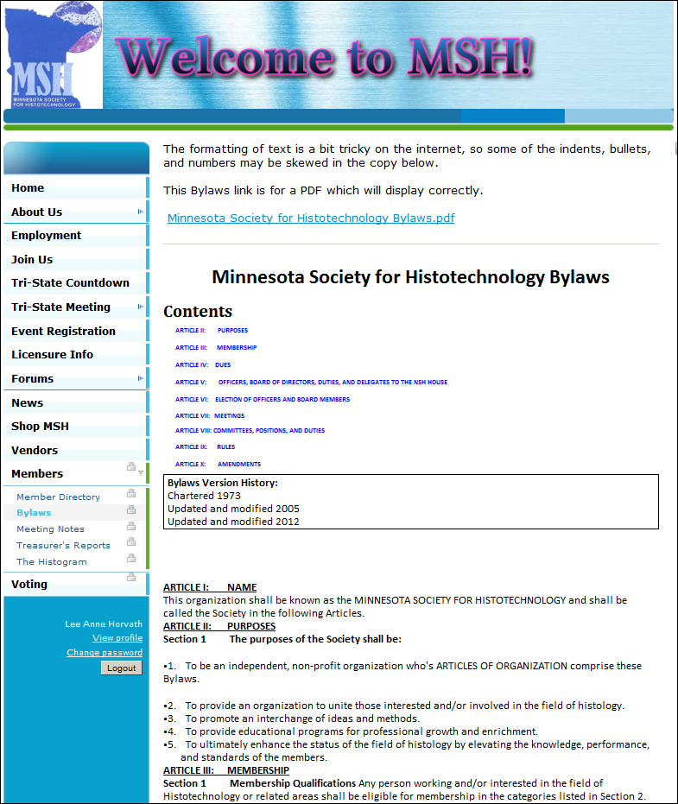
MSH Bylaws
We suggest you click on the PDF to view the document
Formatting gets tricky on the Internet

Slide 41
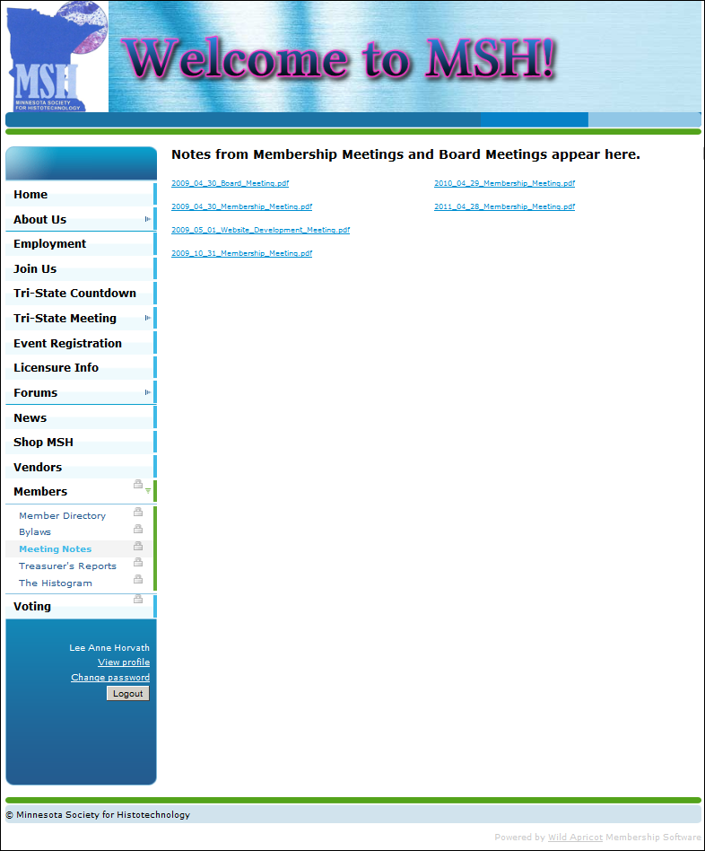
Meeting Notes
Meeting Notes must be approved before posting
As more Notes from earlier Meetings become available we will post them on this page
Send any earlier documents to an Administrator

Slide 42
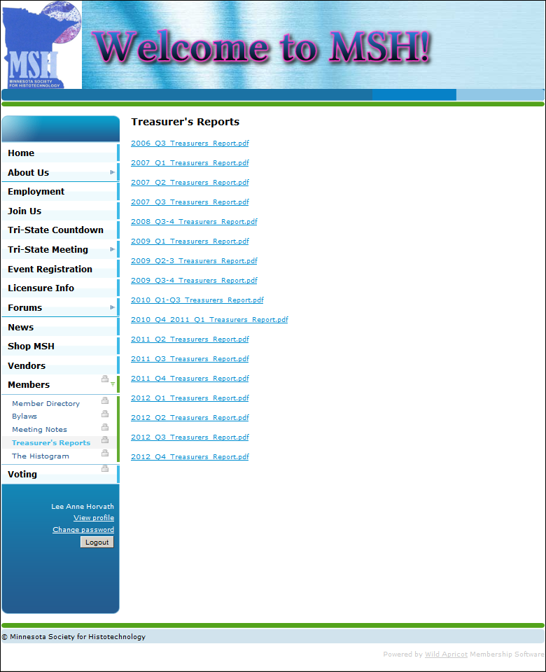
Treasurer’s Reports
Treasurer’s Reports do not require approval prior to posting
As more reports from earlier years become available we will post them on this page
Send any earlier documents to an Administrator

Slide 43
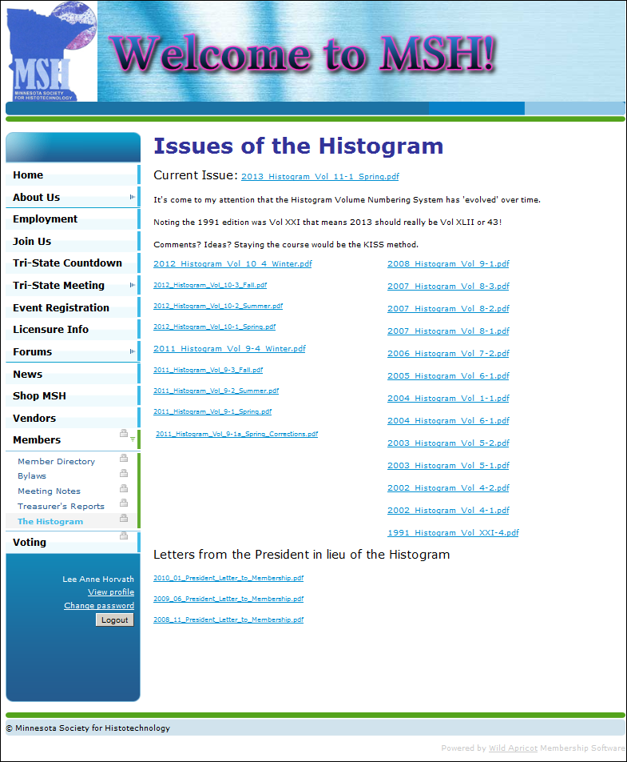
Histogram
Histograms are posted when published
Current issue at the top
As more Histograms become available we will post them on this page
Send any earlier documents to an Administrator

Slide 44
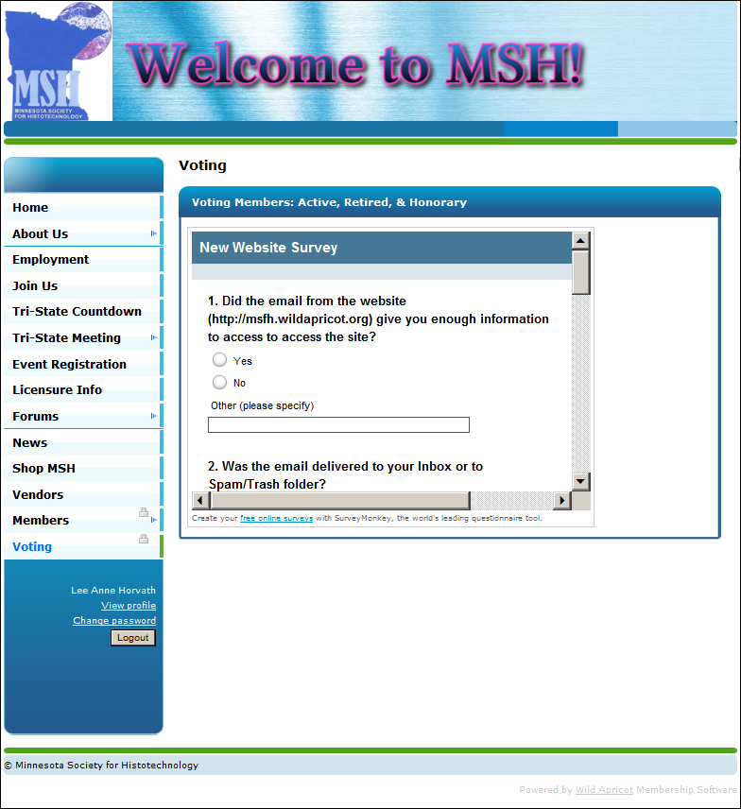
Voting Page
Voting privileges for Active, Retired, & Honorary Members
A six question survey about the website resides on this page currently
Electronic elections are tentatively planned for 2014

Slide 45

Questions?
Ask Lee Anne
Ask Sheri
Ask Michelle
Want a copy of this presentation?
Add your name to the list, I’ll email it to you
Happy National Medical Laboratory Professionals Week!

